Slide 1

Numerical and Experimental Investigation of Blended Wing Body Configuration
Midhun Mv
ME/SER/10009/17
Under the Guidance of
Dr. Partha Mondal
Department of Space Engineering & Rocketry
Birla Institute of Technology Mesra, Ranchi

Slide 2
Introduction
Source: Internet
Conventional Configuration: "Tube and Wing"
Blended Wing Body (BWB)
Hybrid Flying Wing
Flying Wing
The Blended Wing Body aircraft is a blend of
the tail aft and the flying wing configurations:
A wide lift producing center body housing the payload
blends into conventional outer wings.

Slide 3
Literature Review
No. | Title | Inferences
1 | Design of the Blended Wing Body Subsonic Transport [4] -R. H. Liebeck, 2004 | Introduced the concept of Blended wing Body configuration. 800 passenger BWB and conventional configuration airplanes are compared for a 7000 nautical mile(12964 km) design range. Results showed a 15% reduction in takeoff weight, 20% increase in lift/drag ratio and a 27% reduction in fuel burn per seat mile.
2 | Design and Analysis of the Control and Stability of a Blended Wing Body Aircraft [5] -Roberto Merino Martínez, 2015 | The aerodynamic behavior and performance were analyzed using CEASIOM platform, with an special emphasis on its control and stability features. This analysis enables to improve the baseline design and the allocation and size of the control surfaces was studied and optimized.
3 | Longitudinal Aerodynamic Characteristics and Wing Pressure Distributions of a Blended Wing Body Configuration at Low and High Reynolds Numbers [6] -Richard J. Re, 2005 | An experimental investigation to obtain force balance and wing pressure data on a 0.017 scaled model of blended-wing-body configuration (without propulsion systems installation). Tests were conducted in the Langley Research Center National Transonic Facility at various Reynolds number and Mach numbers within the range from 0.25 to 0.86.

Slide 4
Literature Review
No. | Title | Inferences
4 | RANS-based Aerodynamic Shape Optimization of a Blended-Wing-Body Aircraft [7] - Z. Lyu and J. R. R. A. Martins, 2013 | The impact of the various constraints and design variables on optimized blended-wing-body configurations. RANS-based aerodynamic shape optimization can become a practical aircraft design tool that is especially useful for the design of BWB configurations.
5 | Aerodynamic considerations of blended wing body aircraft [8] -N.Qin et al., 2004 | A progressive aerodynamic study of a blended wing body configuration and three-dimensional aerodynamic surface optimisation of the BWB within a European project(MOB) is carried out.
6 | Numerical Study of Aerodynamic Characteristics on Blended Wing Body Aircraft with Small Canard [9] -Zurriati Mohd Ali, 2017 | CFD analysis were performed to determine the aerodynamics characteristic (Cl, L/D and Cm) of BWB incorporated with the canard. Reported an improved stability in the BWB configuration by incorporating a small canard and concluded that these configurations can improve pitching moment of BWB.

Slide 5
Motivation
The need for change.
Blended Wing Body aircraft was conceptualized as a result of a growing demand for an environmentally friendly, aerodynamically efficient aircraft that can carry large number of passengers over long ranges at reduced direct operating cost.
A very limited study has been done over the flow behavior of the Blended wing Body at low subsonic region.

Slide 6
Objectives
The main objective of the current project is to design and study the aerodynamic behavior of a Blended Wing Body (excluding the propulsion systems).
Validate some standard 2D cases for available numerical methods and turbulence models in OpenFOAM.
Numerical results of the Blended Wing Body are aimed to obtain the aerodynamic coefficients and the flow physics over the body.
Experimental analysis of the BWB supports and validates the numerical results obtained.

Slide 7
Methodology
Designing of the model using SolidWorks.
Fabrication of the designed model.
Structured grid generation and mesh refinement process.
Simulating the cases using OpenFOAM and discussion on the results that is to be acquired.
Experimental analysis of the model.
Post-processing.

Slide 8
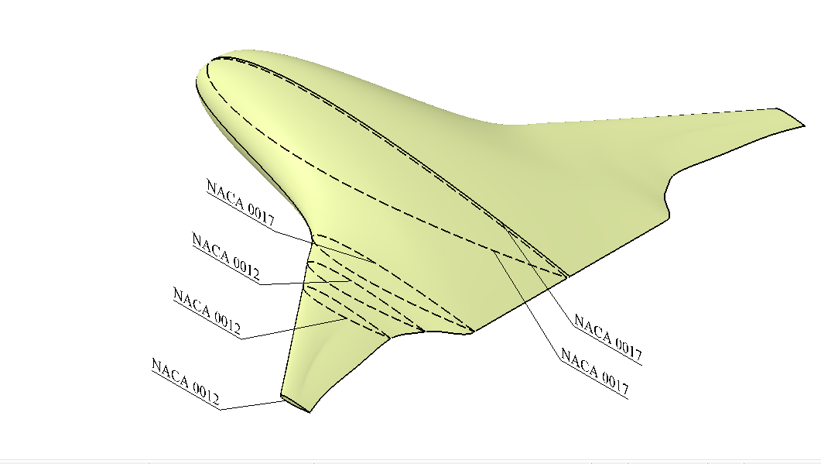
Designing and Modelling of the Blended Wing Body
The model is defined by two different airfoil shapes, NACA 0012 and NACA 0017 placed at six sections blended smoothly to form a wing.
The half model was used for the Computations.
Experiments were carried out on a full 3D model.
Specifications of the BWB model
Root Chord Length | 157.14mm
Span | 215.85mm
Aspect Ratio | 3.2
Reference Area | 14547mm²
Sweep Angle (leading edge) | 71.66º
Sweep Angle (outer wing) | 38.52º

Slide 9
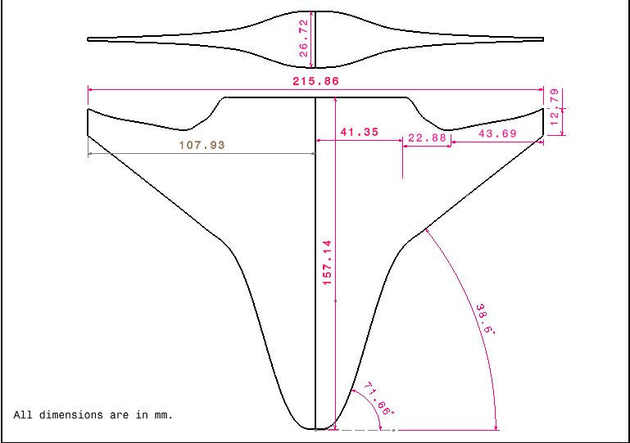
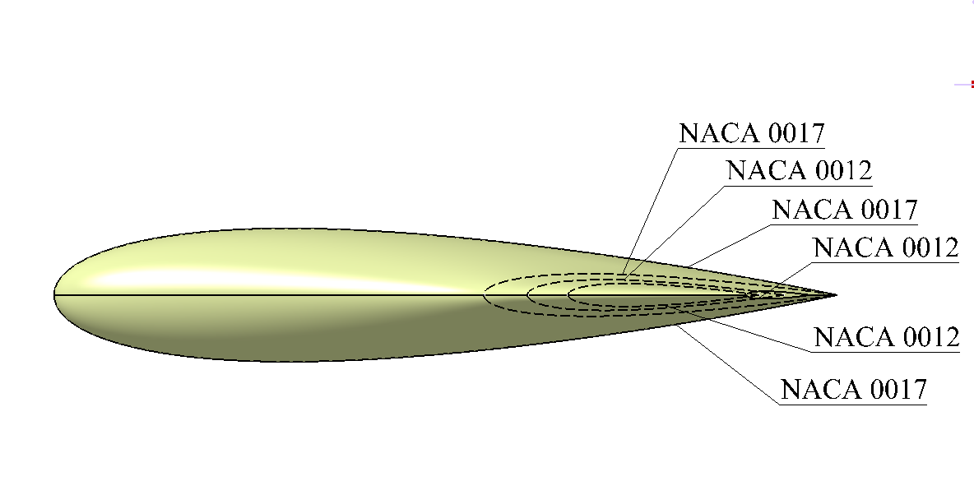
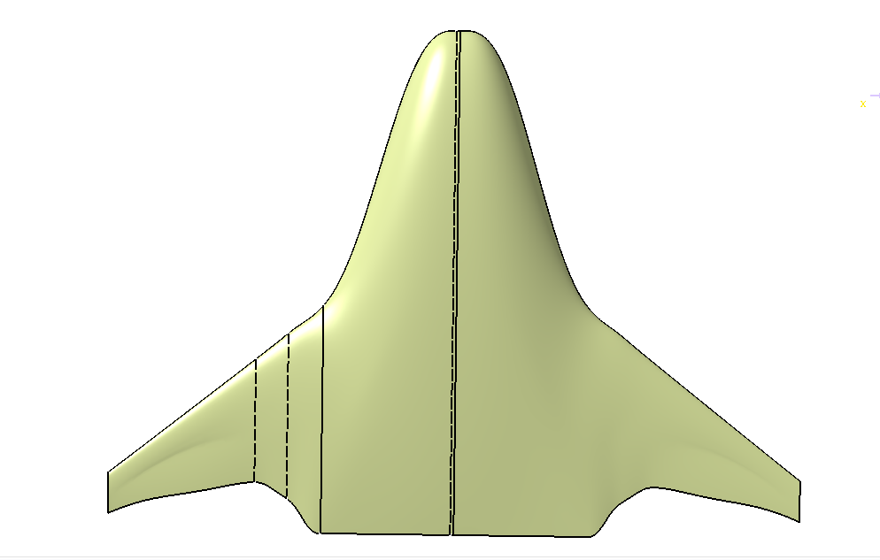
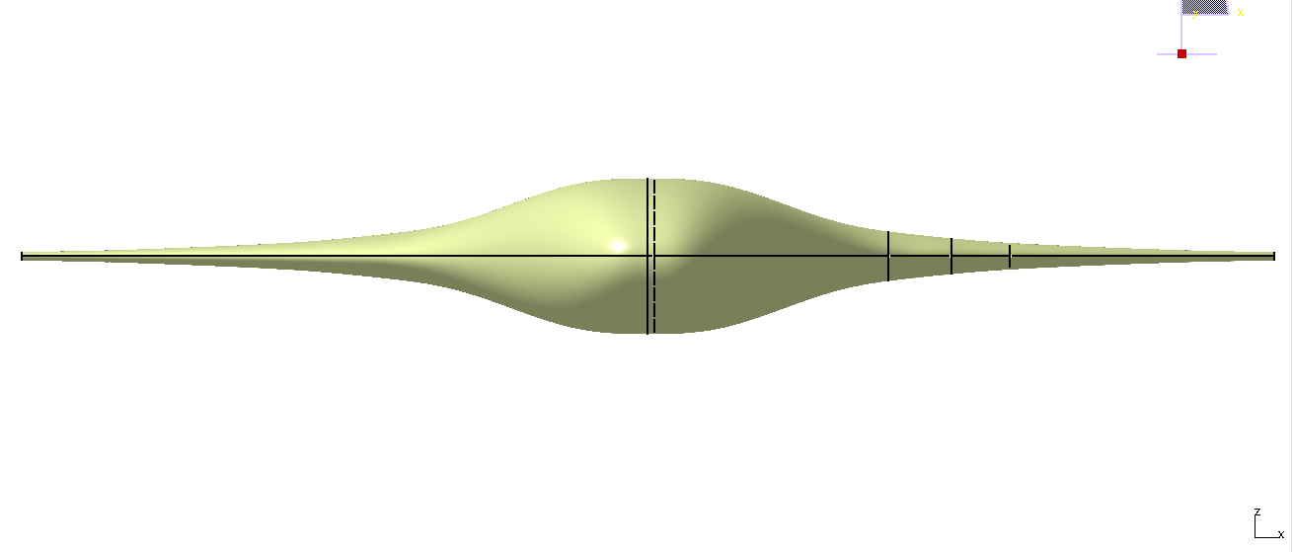
Different views of the model
Top view
Front view
Side View
Isometric view
Top View
Front View

Slide 10
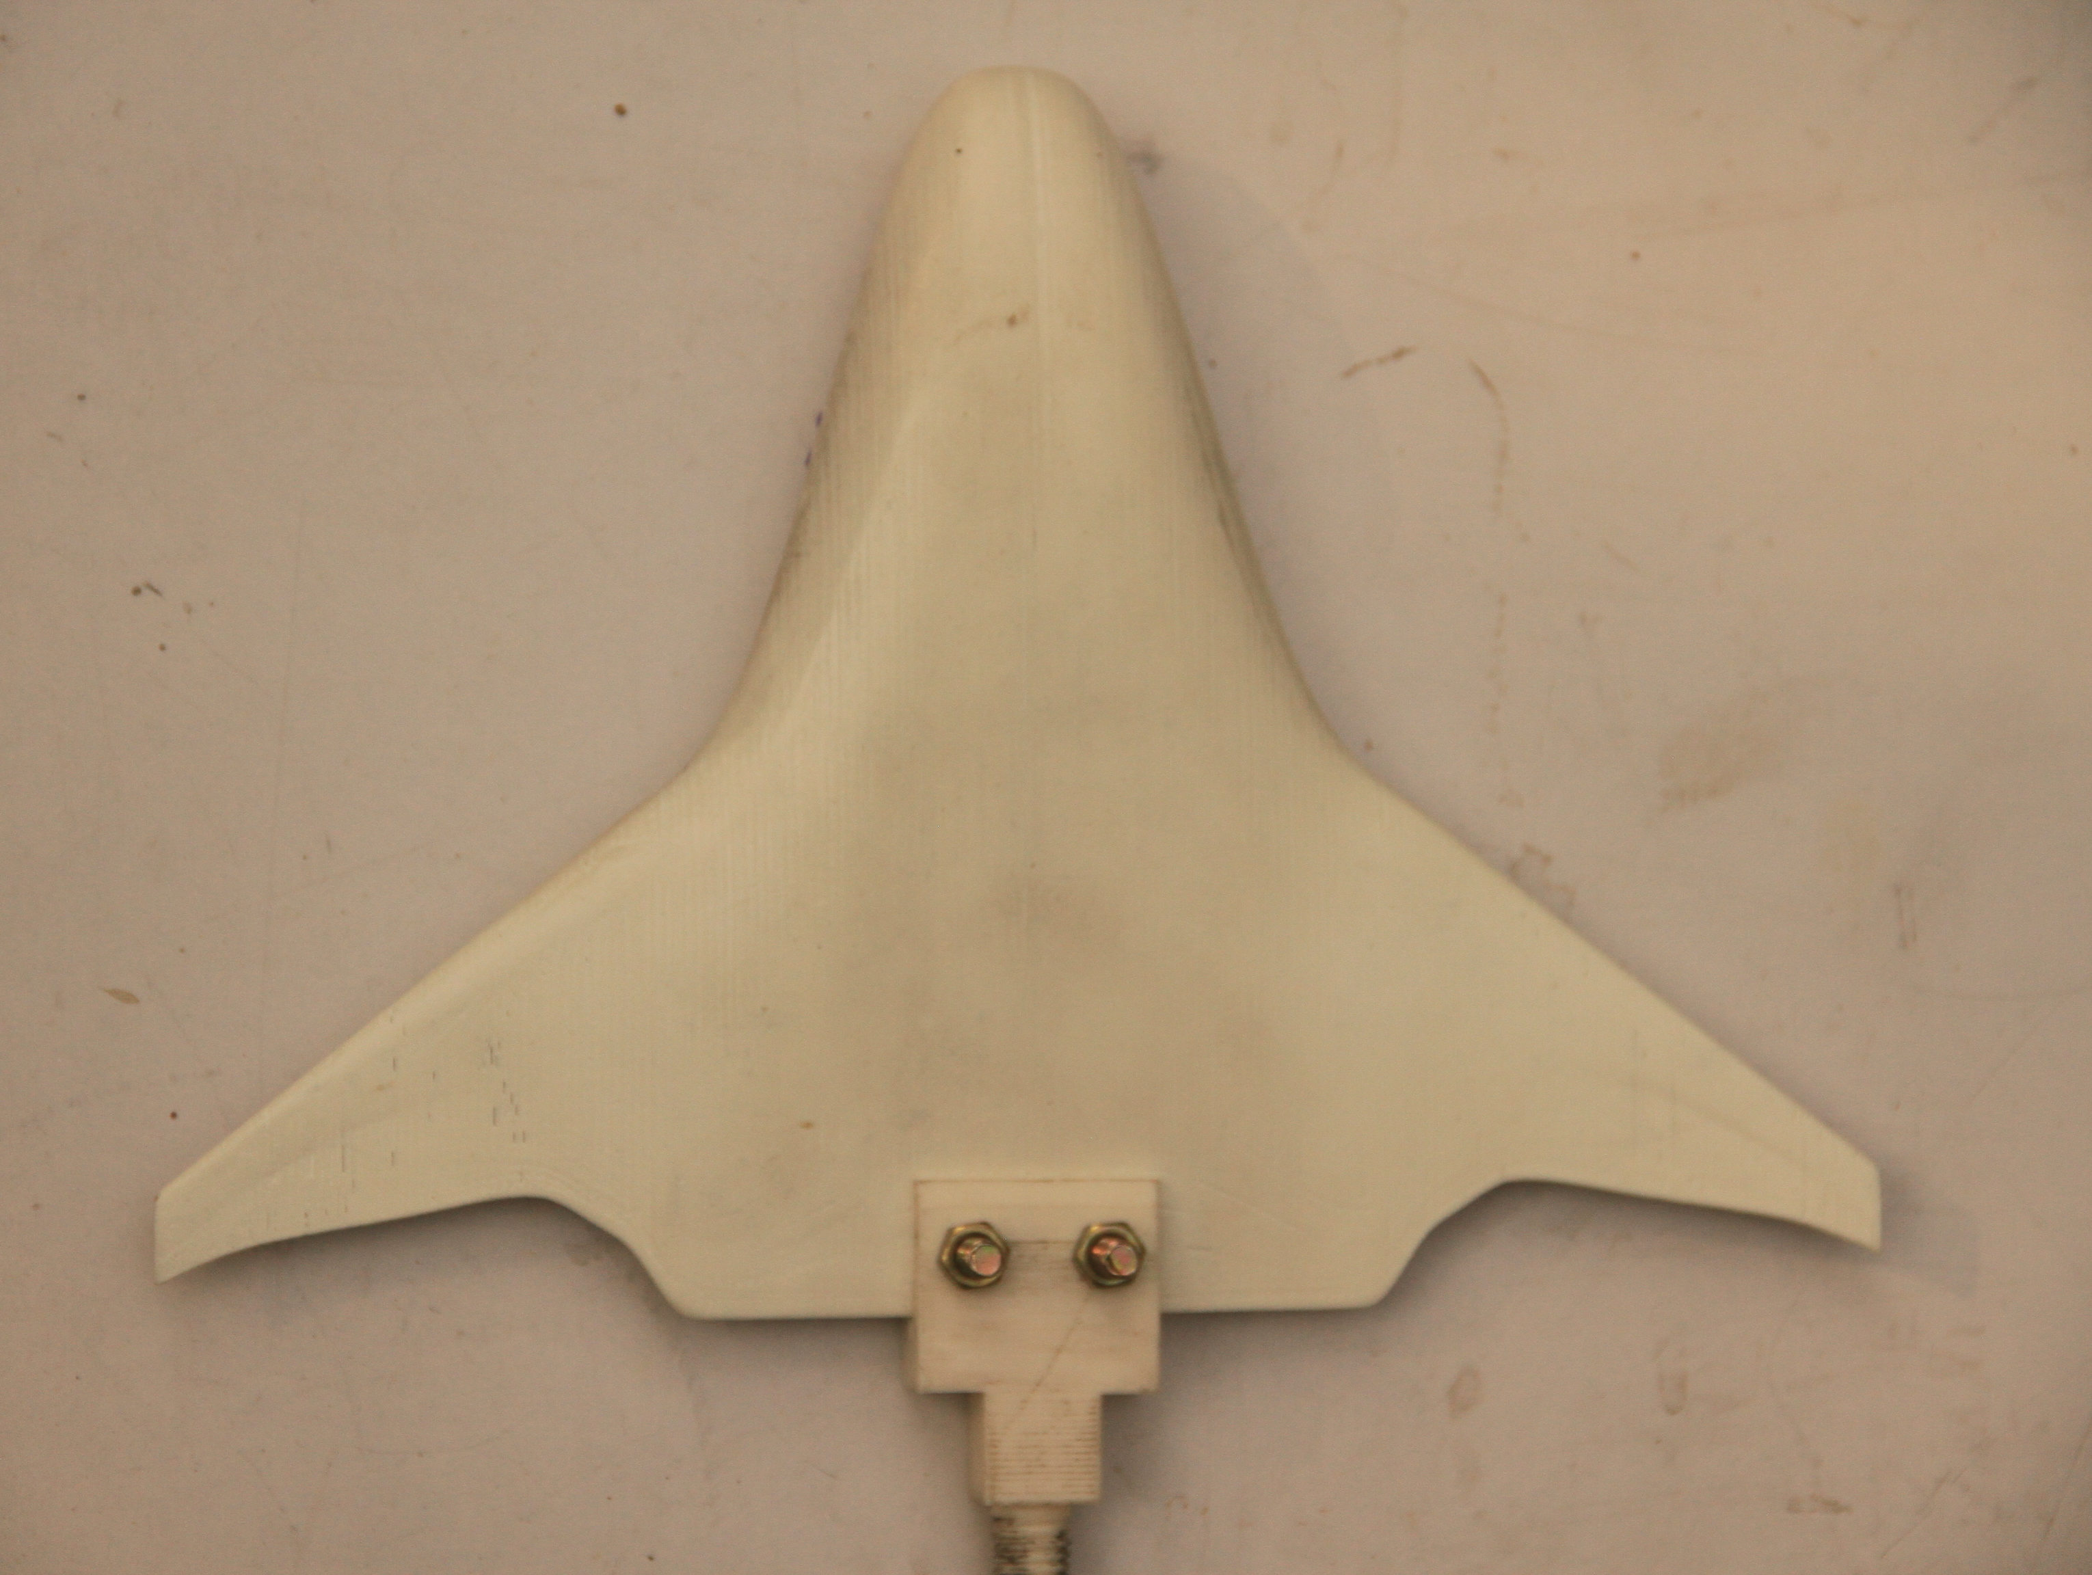
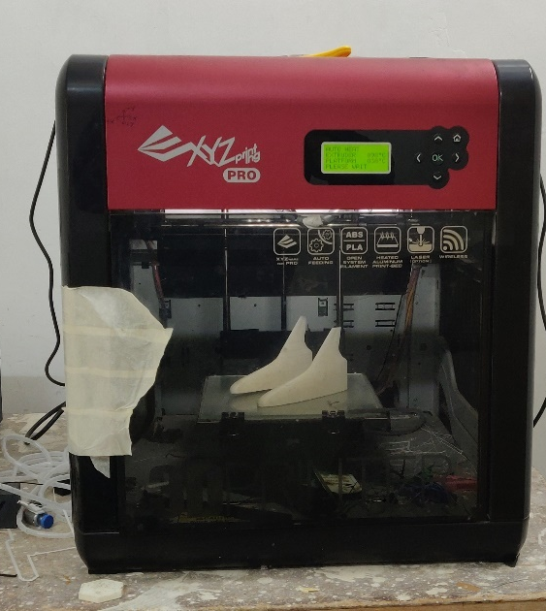
Fabrication of the model
The model used for experiments was fabricated using a 3D Printer.
The BWB model was printed in two halves and then combined together to form the whole geometry. The model was then coated with some layers of spray paint to increase the smoothness of the surface.

Slide 11
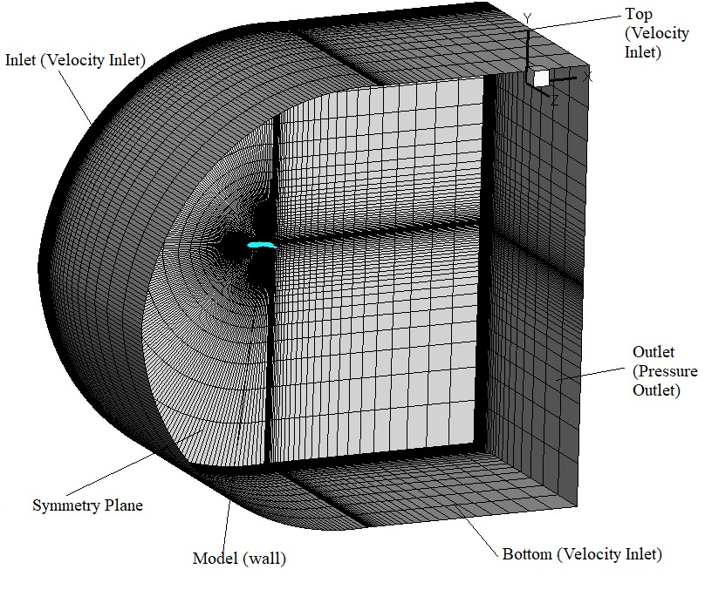
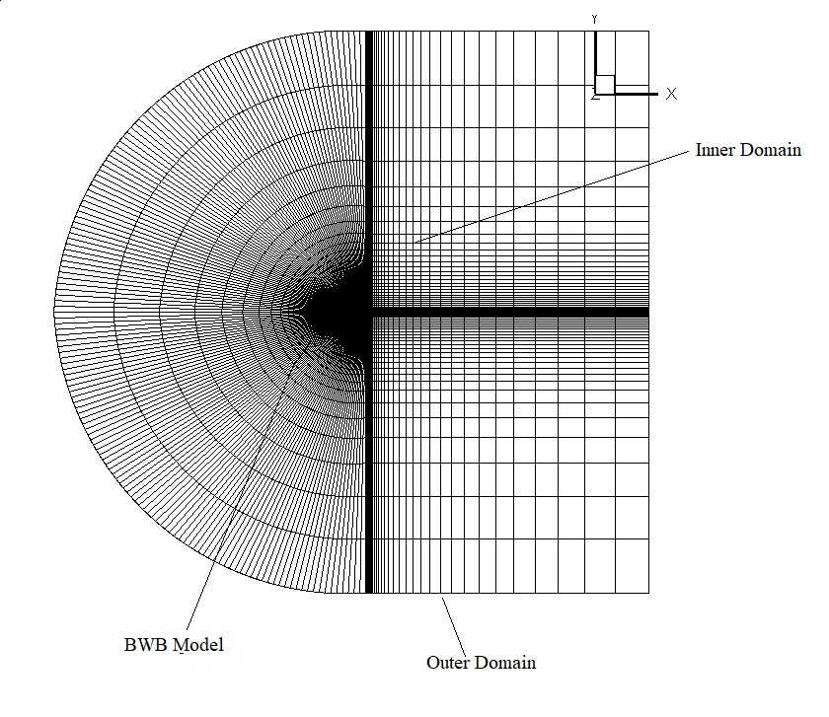
Boundary conditions for the domain

Slide 12
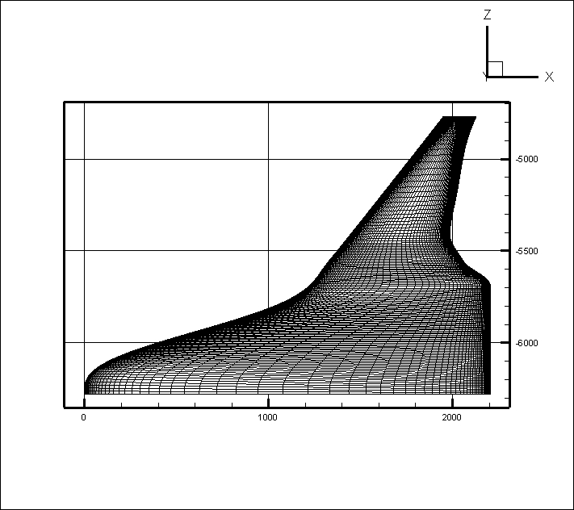
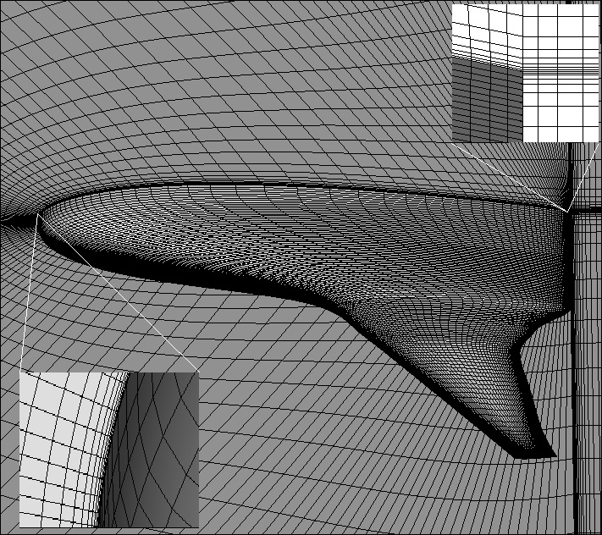
Closer View of the Mesh over the Model

Slide 13

Computational Analysis

Slide 14
File structure for OpenFOAM simulation
0 ("time" directory starting with T=0, giving conditions from the initial step)
U (flow velocity)
nuTilda
nut (turbulence eddy viscosity)
p (pressure)
constant (physical properties)
turbulenceProperties (kOmegaSST, SA)
transportProperties (Transport Model e.g. Newtonian)
polyMesh
system (the info on the computational system used to analyse the problem)
controlDict (the main dictionary for controlling the simulation)
decomposeParDict (dictionary for parallel processing)
fvSchemes
fvSolution

Slide 15
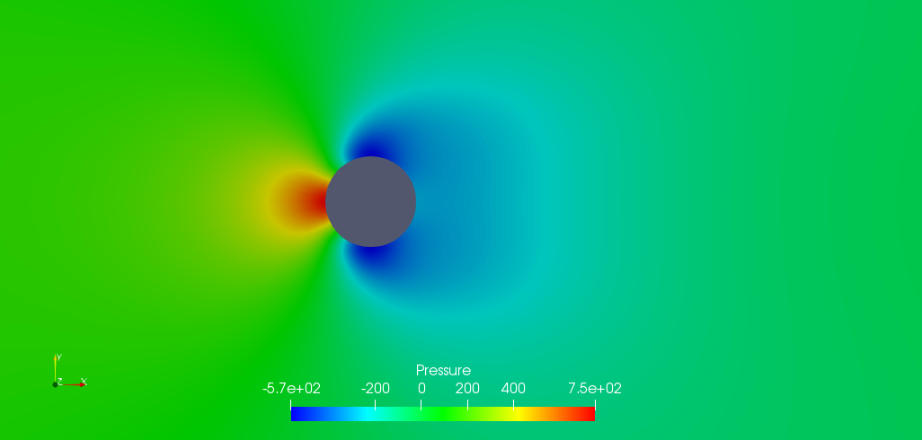
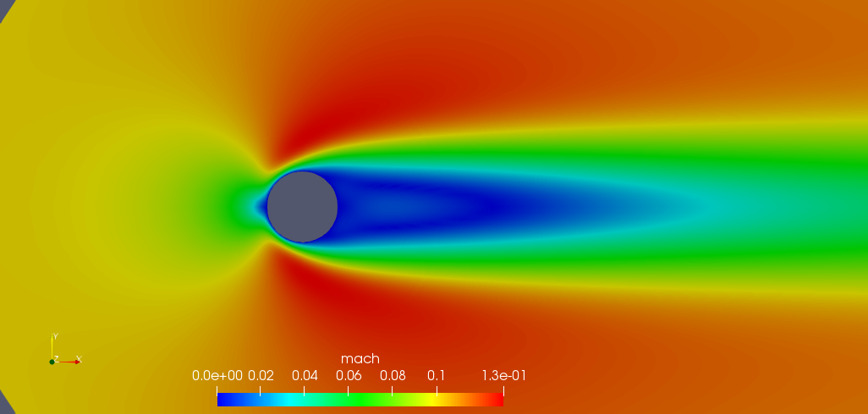
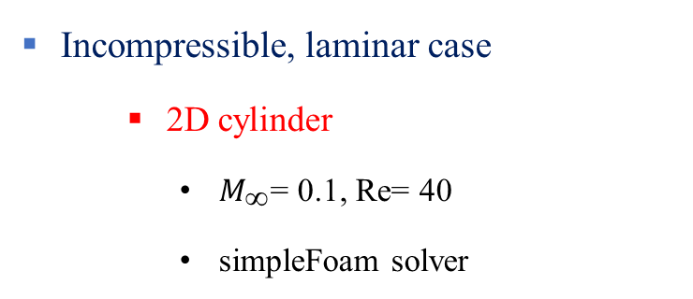
Standard Test cases for Validation
Incompressible, laminar case
2D cylinder
$M_{\text{∞}}$= 0.1, Re= 40
simpleFoam solver
The Cp distribution compares closely with the experimental data and it validates the simpleFoam for incompressible flow simulation.
Hence simpleFoam solver is used for incompressible cases.

Slide 16
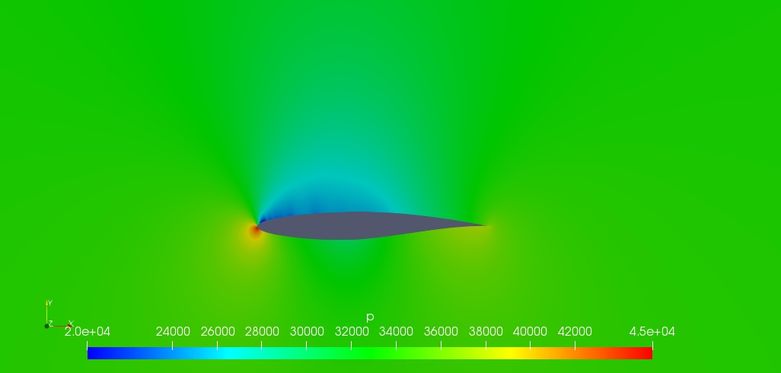
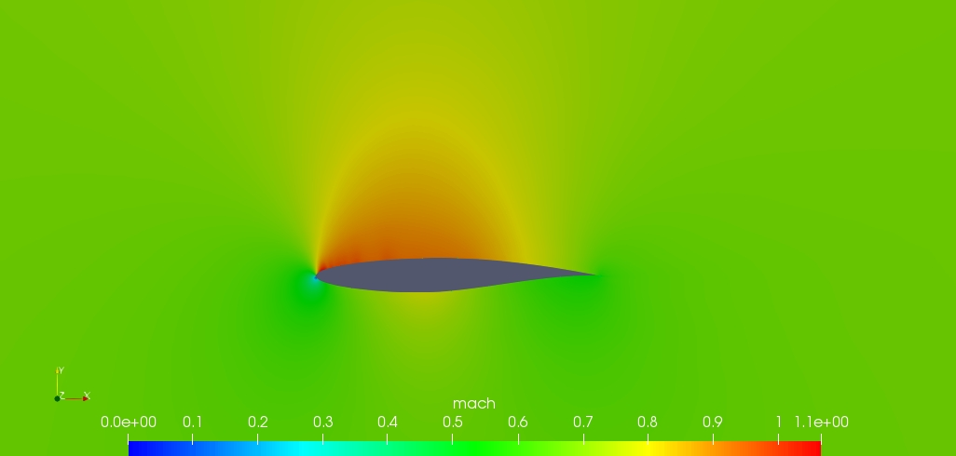
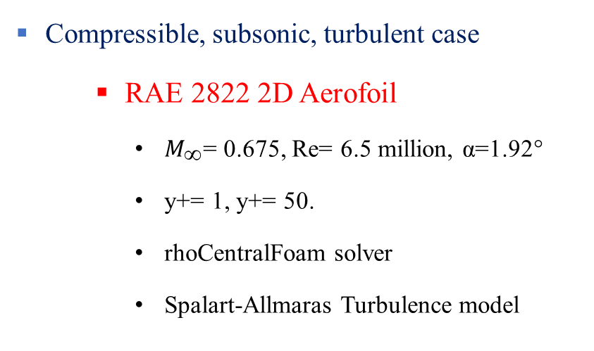
Compressible, subsonic, turbulent case
RAE 2822 2D Aerofoil
$M_{\text{∞}}$= 0.675, Re= 6.5 million, α=1.92°
y+= 1, y+= 50.
rhoCentralFoam solver
Spalart-Allmaras Turbulence model
This numerical analysis confirms that the wall function approach can be used to reduce the mesh size.
y⁺= 50 grid with wall function is used for the BWB geometry.
The results for helped in choosing and finding a correct set-up for turbulence model.

Slide 17
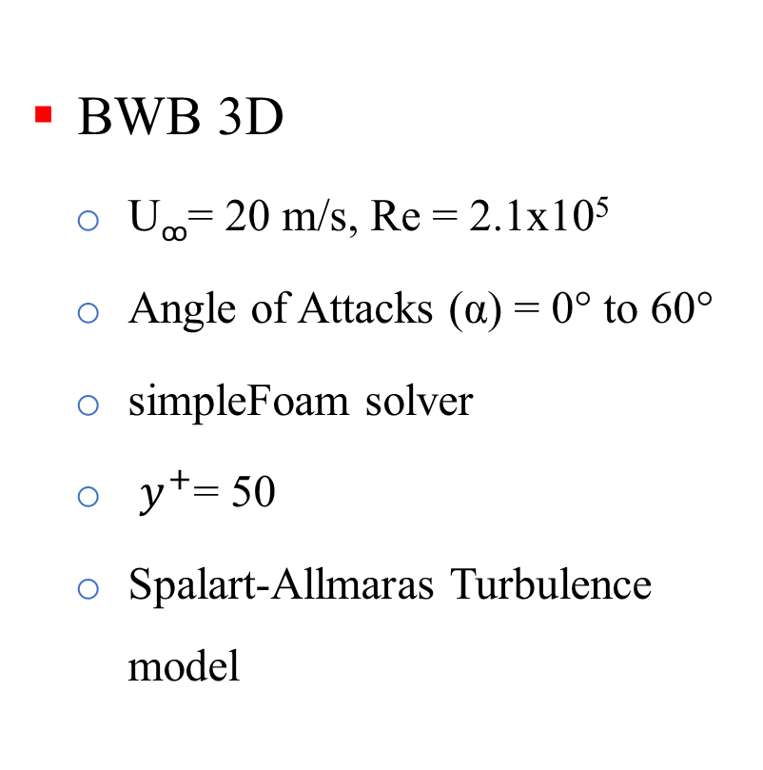
Flow Conditions
BWB 3D
U_{ꝏ}= 20 m/s, Re = 2.1x10⁵
Angle of Attacks (α) = 0° to 60°
simpleFoam solver
$y^{+}$= 50
Spalart-Allmaras Turbulence model

Slide 18
Aerodynamic Characteristics of BWB
At α=0°, C_{L} is nearly zero.
C_{L} increases linearly with increasing angle of attack upto 40°.
The BWB model is stalled at an angle of attack of 45°.
At low angles of attack, C_{D} is constant.
After α=10°, C_{D} increases with increasing angle of attack.
Increase in drag at higher angle of attack is due to increasing pressure drag.

Slide 19
The maximum value of L/D is achieved at an angle of attack of 6º. Hence the optimum flight configuration of the BWB body is at α = 6º.
Initially, the lift coefficient increases with the drag coefficient, later on the lift coefficient almost becomes constant with the increasing drag coefficient.

Slide 20
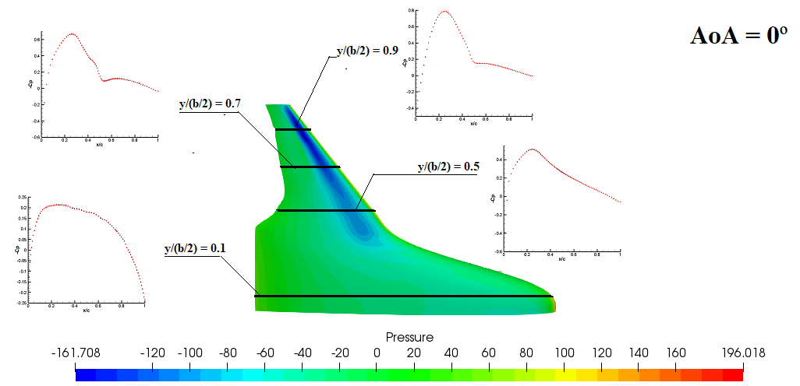
Cp over the top surface of BWB at indicated span-wise location

Slide 21
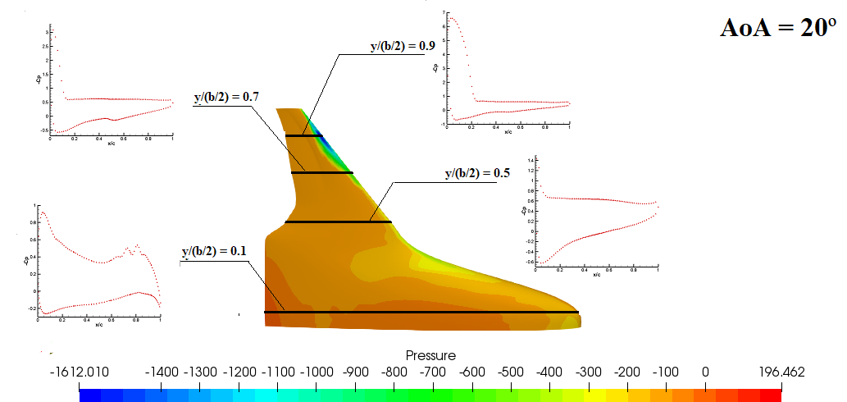

Slide 22
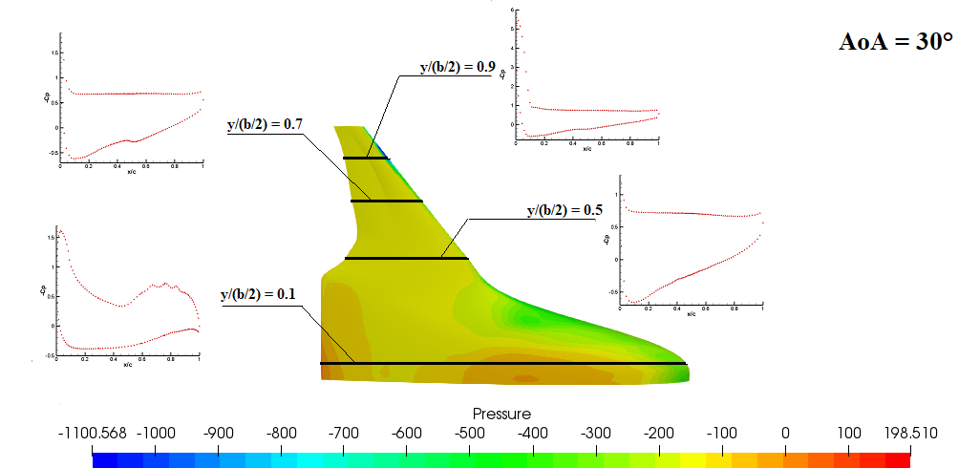

Slide 23
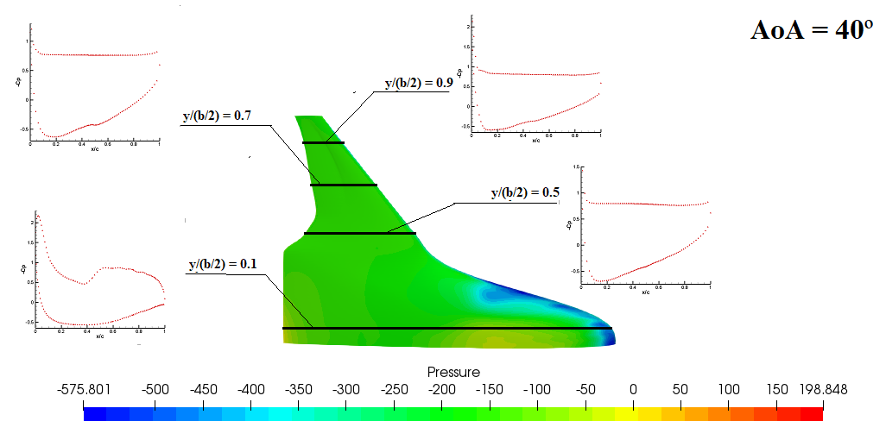

Slide 24
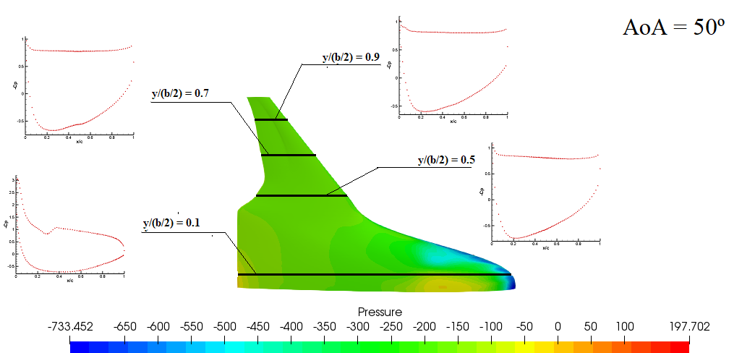

Slide 25
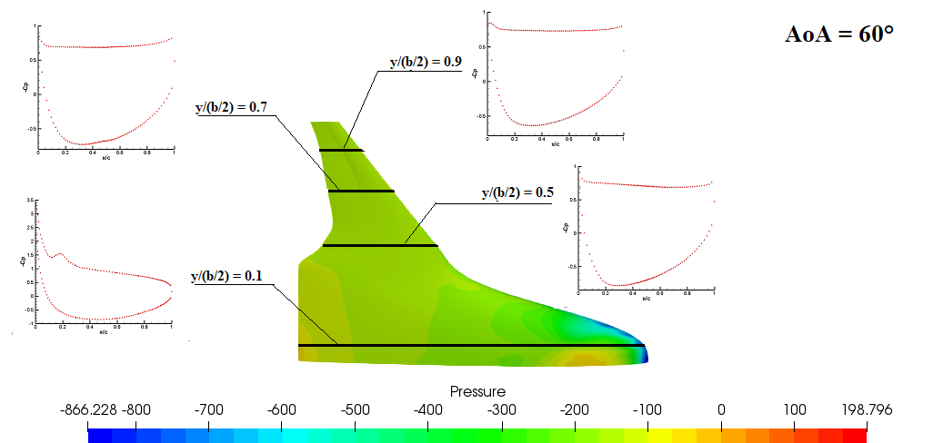

Slide 26
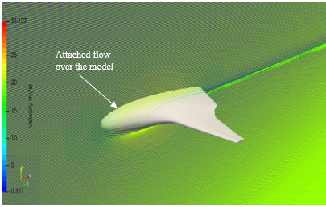
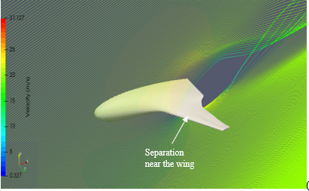
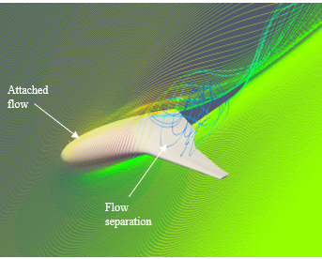
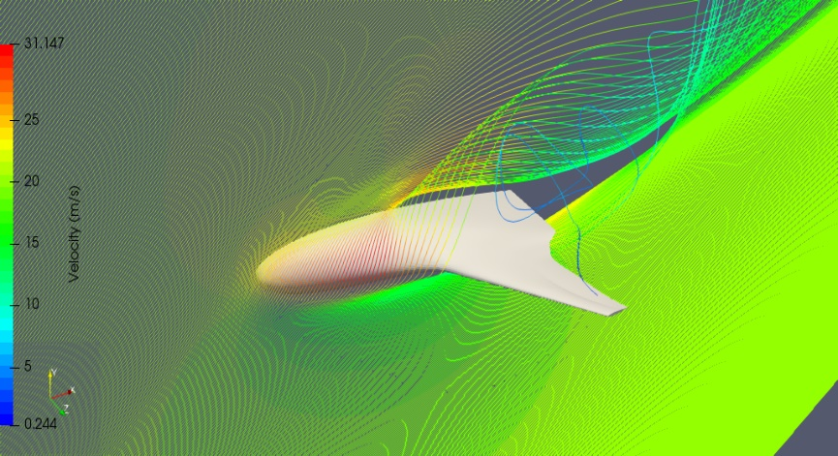
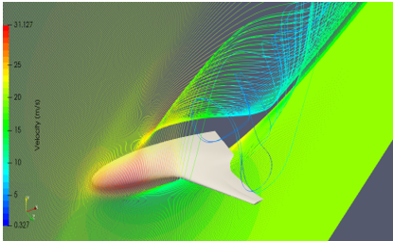
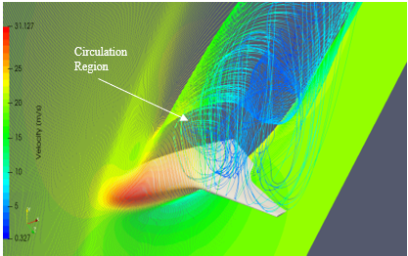
Path lines at different Angle of Attack
α=0°
α=20°
At α=0°, the flow is fully attached to the body.
At α=20°, the flow has separated at the wing and wing is stalled.
At α=30°, flow is attached at the fuselage part and the body continues to produce lift.
The circulation region grows stronger with the increasing angles of attack.
After α=45°, flow is separated for most of the body.
α=30°
α=40°
α=50°
α=60°

Slide 27
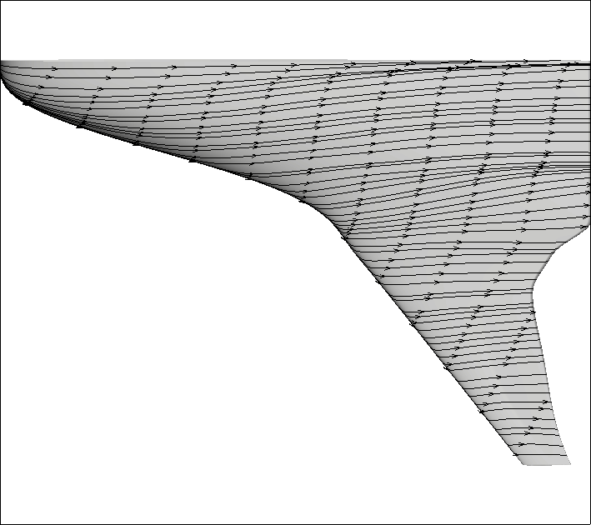
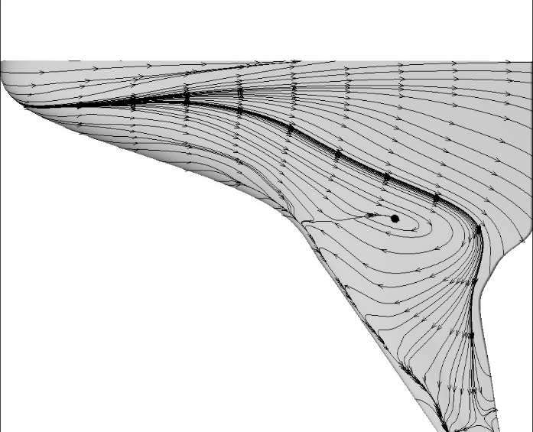
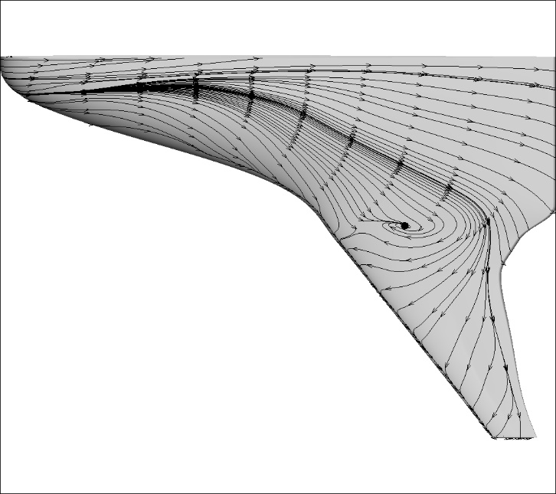
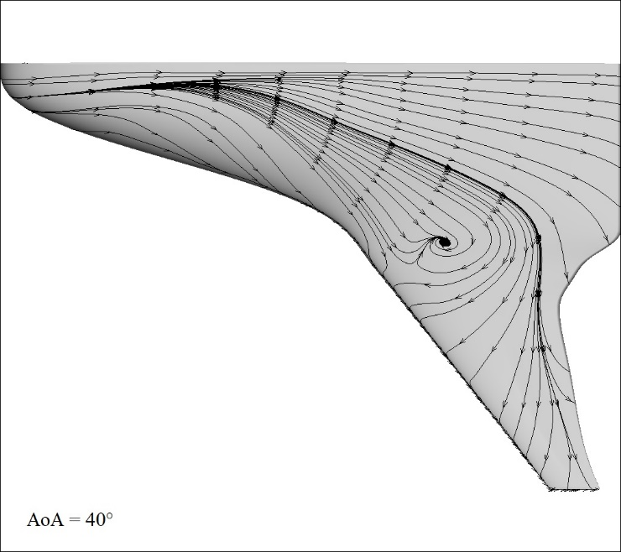
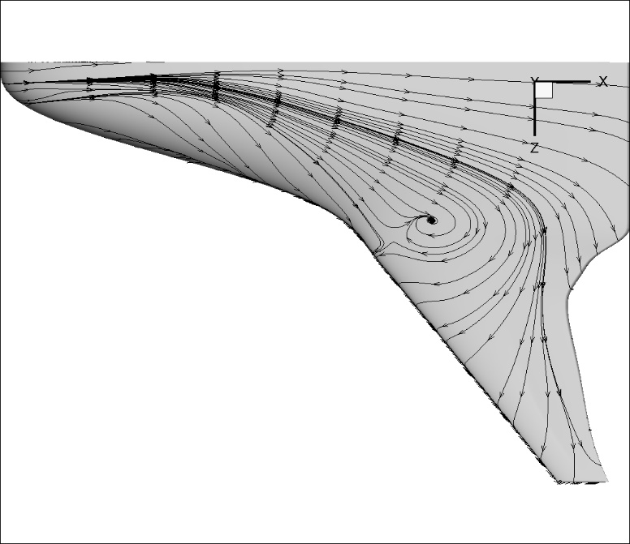
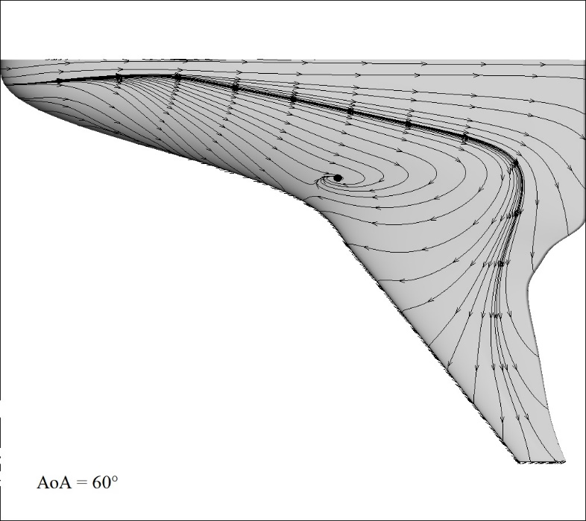
Streamlines over the top surface at different Angle of Attack
At α=0°, streamlines are straight and attached to the body.
At α=20°, streamlines near the leading edge of the wing shows separation.
The circulation region grows stronger with the increasing angles of attack.

Slide 28
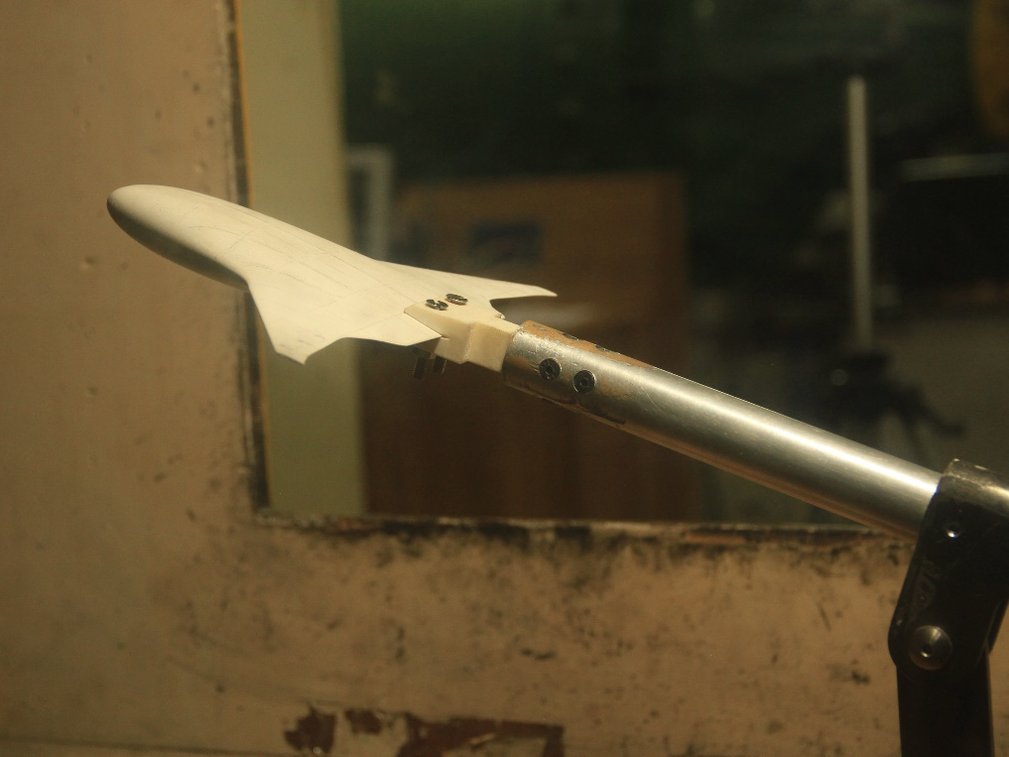
Experimental Analysis

Slide 29
Aerodynamic Characteristics of BWB
C_{L} increases with increasing angle of attack as excepted.
The experimental results matches closely with the computational results.
At higher angles of attack, experimental values starts deviating from the computational values.

Slide 31
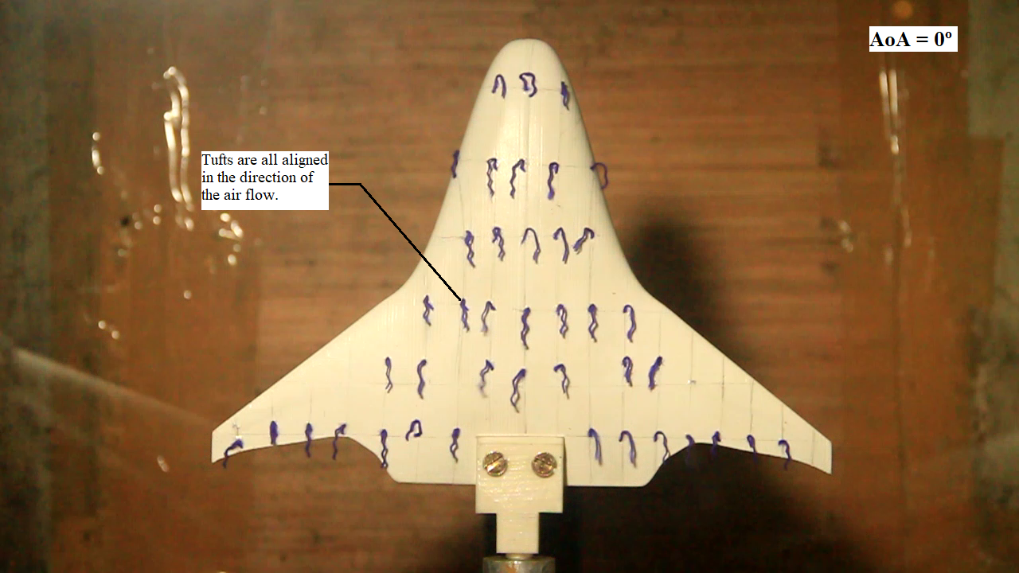
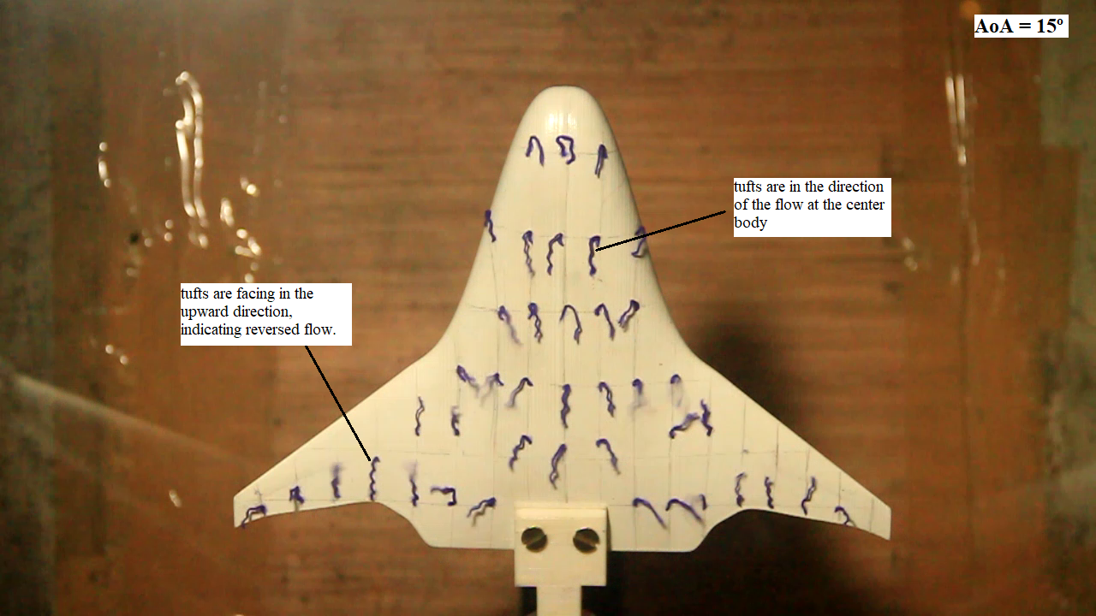
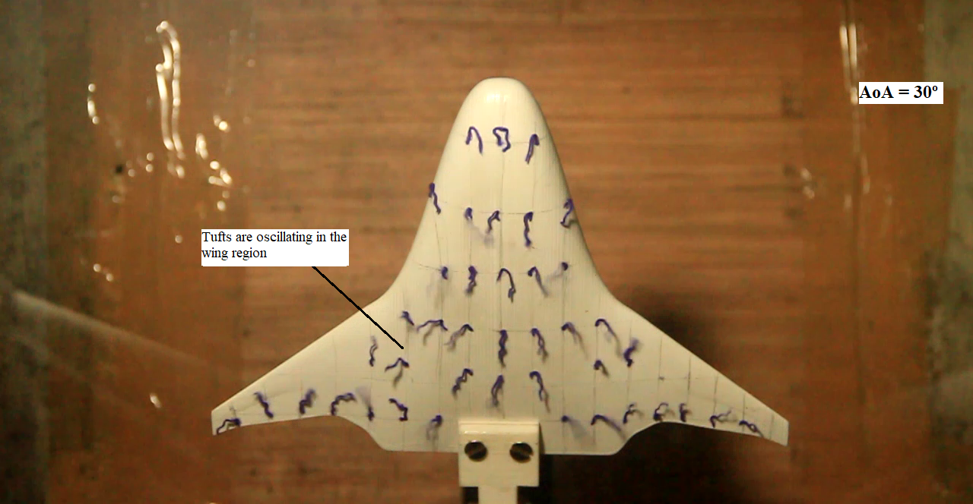
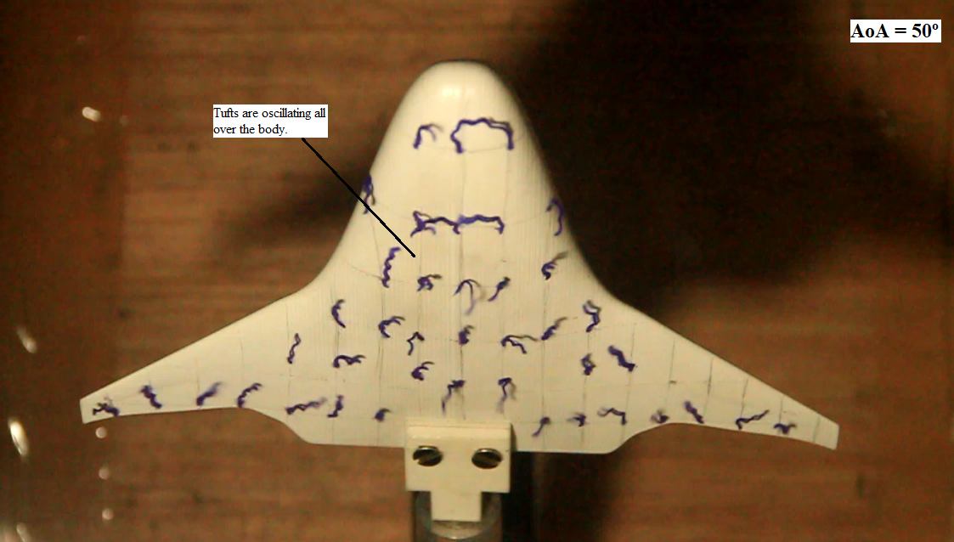
Tuft Flow Visualization
Visualization using tuft during wind tunnel tests is also done to complete the analysis where the stall progression patterns can be clearly observed.

Slide 32
References
[1] R. Liebeck, M. Potsdam, M. Page, Blended wing body Analysis and Design, in: 15th Applied Aerodynamics Conference, American Institute of Aeronautics and Astronautics, 1997.
[2] R.H. Liebeck, M.A. Page, B.K. Rawdon, Blended-wing-body subsonic commercial transport, AIAA Paper 438, 1998.
[3] R.H. Liebeck, Blended wing body design challenges, in: AIAA International Air and Space Symposium and Exposition: The Next 100 Years, American Institute of Aeronautics and Astronautics, 2003, pp.14–17.
[4] R.H. Liebeck, Design of the blended wing body subsonic transport, J. Aircraft Vol.41(1), 2004, pp. 10–25.
[5] Roberto Merino-Martinez, Design and analysis of the control and stability of a Blended Wing Body aircraft, CEAS 2015 paper no. 17, 2015.
[6] Richard J. Re, Longitudinal Aerodynamic Characteristics and Wing Pressure Distributions of a Blended Wing Body Configuration at Low and High Reynolds Numbers, NASA/TM-2005-213754, 2005.
[7] Z. Lyu and J. R. R. A. Martins, RANS-based Aerodynamic Shape Optimization of a Blended-Wing-Body Aircraft, 43rd AIAA Fluid Dynamics Conference and Exhibit, 2013.
[8] N. Qin, A. Vavalle, A. Le Moigne, M.Laban, K.Hackett, P.Weinerfelt, Aerodynamic considerations of blended wing body aircraft, Progress in Aerospace Sciences 40, 2004, pp. 321–343.
[9] Zurriati Mohd Ali, Wahyu Kuntjoro, Wirachman Wisnoe, Rizal Effendy Mohd Nasir and Noor Iswadi Ismail, Numerical Study of Aerodynamic Characteristics on Blended Wing Body Aircraft with Small Canard, Pertanika J. Sci. & Technology 25 S, 2017, pp. 9–18.
[10] GeoffreyLarkin, GrahamCoates, A design analysis of vertical stabilisers for Blended Wing Body aircraft, Aerospace Science and Technology, 64, 2017, pp.237–252
[11] P. Dehpanah, A. Nejat, The Aerodynamic Design Evaluation of a Blended-Wing-Body Configuration, Aerospace Science and Technology 43, 2015, pp. 96–110.
[12] Paul Okonkwo, HowardSmith, Review of evolving trends in blended wing body aircraft design, Progress in Aerospace Sciences, 82, 2016, pp.1–23

Slide 33
Thank you

